Slide 1

Professional Skills
Bernardo Josué Correia Alves

Slide 2
Table of contents
Personal Leadership
Ethics and project-based work practices (collaboration)
Communication

Slide 3
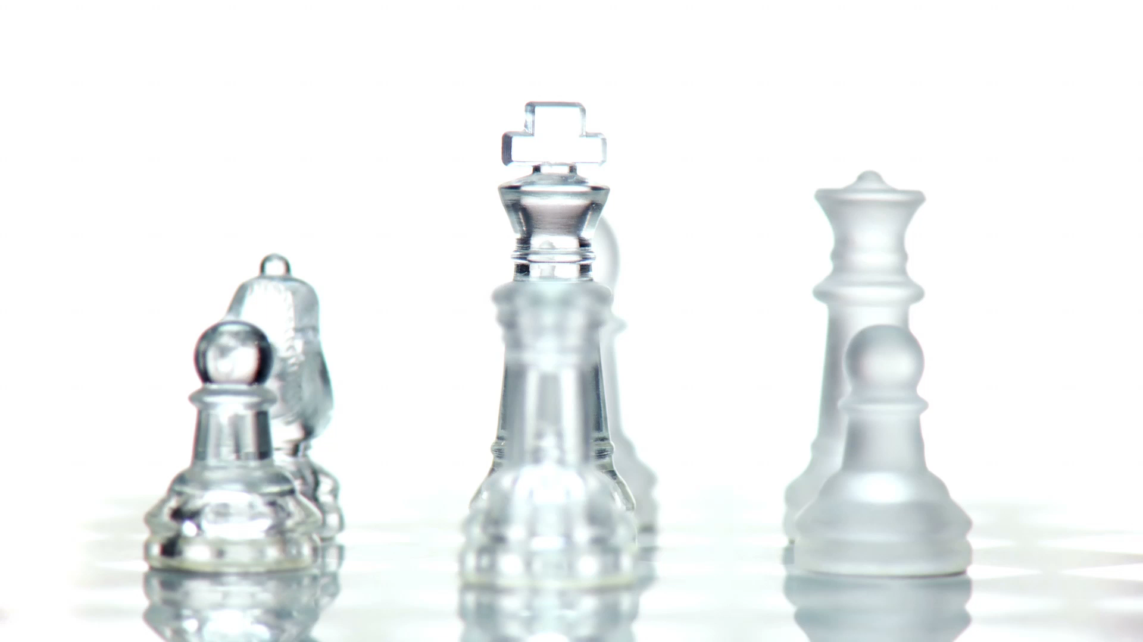
Personal Leadership

Slide 4

Term 1 Team Leader

Slide 5
Term 1 Team Leader
Elected team leader
3 members
Funmy, Gabriel, Alex
Different personalities
Strengths

Slide 6

Term 2 team adviser

Slide 7
Term 2 team adviser
Working with 6 other team member
Rares leader
More stressful project
A lot of end decision came out to me
Number 1 help source

Slide 8

Ethics and project-based work practices (collaboration)

Slide 9
How do I approach projects
Let’s use the START method for this
Situation: Project term 2
Task:
Action
Result:
Reflection
Future
Notes:
Worked a lot given different team members different tasks.
Build a server network drawing and a website. While doing different documentation
Action: Worked a lot given different team members different tasks.
I would rate my work an 8.5 out 10. I learned form it that when everyone gives equal amount of energy to the project it becomes easier. I could improve how I approach my vacation for the project stress
I applies my prior IT knowloeges and my apility to make my team members better.
A sucefull project
Plan better

Slide 10

Communication

Slide 11

Receiving feedback

Slide 12
Receiving feedback
Feedback received from Paul and Cate
Prior knowledge.
initiative
some conflicts
May stack with his personality
We achieve always the end goal
Stubborn
Make people feel annoyed

Slide 13

Giving feedback

Slide 14
Given feedback
To Paul and Cate

Slide 15

Summary communication

Slide 16
Summary communication
Communication is key.
I am always open to give feedback
Or to just talk with people
In a team every member must talk and be on the same level

Slide 17

Summary

Slide 18

Thank you for listening

